Slide 1
CLINIC APPOINTMENT
& PRESCRIPTION MANAGEMENT SYSTEM
Java-Based Mini Project
Student Names: Keerthi sri
Nishita.S
Roll Numbers: Keerthi- 2620030621
Nishita- 2620030581
Faculty Guide: V.Gopi Krishna

Slide 2
1. Introduction
02
Clinic Appointment and Prescription Management System is a simple Java application.
It helps a clinic manage patient details, doctor details, appointments and prescriptions.
The system reduces repeated manual work and keeps information organized.
Built using beginner-friendly Java concepts such as classes, objects, ArrayList, Scanner, methods and control statements.

Slide 3
2. Problem Statement
03
Manual clinic records can be difficult to maintain and update.
Appointment details may be written in registers or handled separately.
Prescription information can be difficult to find later.
There is a need for one simple system to organize basic clinic records.

Slide 4
3. Objectives
04
Register and store patient details.
Display available doctors and their specializations.
Book and view patient appointments.
Add and view prescriptions.
Validate patient and doctor IDs before creating records.
Provide a simple menu-driven Java application.

Slide 5
4. Existing System
05
Patient details are often recorded manually.
Appointments may be managed using paper registers or separate notes.
Prescriptions may be stored on paper.
Searching and updating records takes more effort.
Data is not managed through one simple application.

Slide 6
5. Proposed System
06
Use one Java application for basic clinic management.
Patient, doctor, appointment and prescription information is handled through separate classes.
Menu-driven options make the system easy to use.
Input validation prevents appointments or prescriptions for unknown IDs.
Records are stored during program execution using ArrayList.

Slide 7
6. System Architecture
07
User / Receptionist
↓
Java Console Interface
↓
Patient Module | Doctor Module | Appointment Module | Prescription Module
↓
ArrayList-based Data Storage
Note: This academic version stores data in memory while the program is running.

Slide 8
7. Functionalities
08
Patient Registration — enter name, age and phone number.
Doctor Management — view doctor ID, name and specialization.
Appointment Booking — select patient, doctor, date and time.
Appointment Viewing — display saved appointment records.
Prescription Management — add medicine and dosage for a patient.
Prescription Viewing — display saved prescription records.
Exit — safely close the application.

Slide 9
8. Implementation – Java Code
09
Main class: ClinicManagementSystem
Patient, Doctor, Appointment and Prescription classes store related data.
Scanner is used for keyboard input.
ArrayList stores records during execution.
switch-case controls the main menu.
Methods divide the program into simple tasks.
--ss

Slide 10
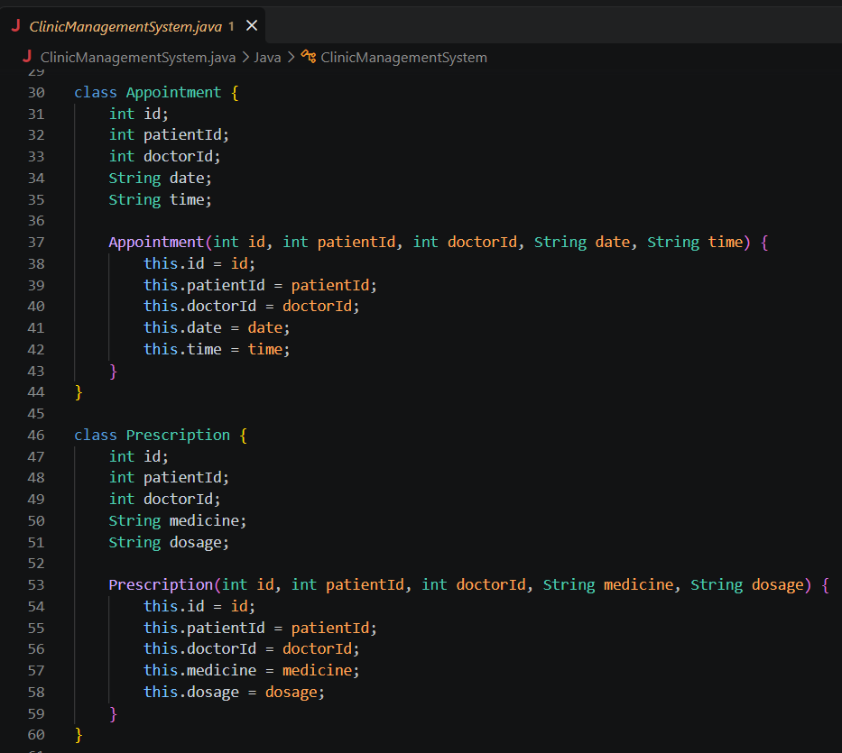
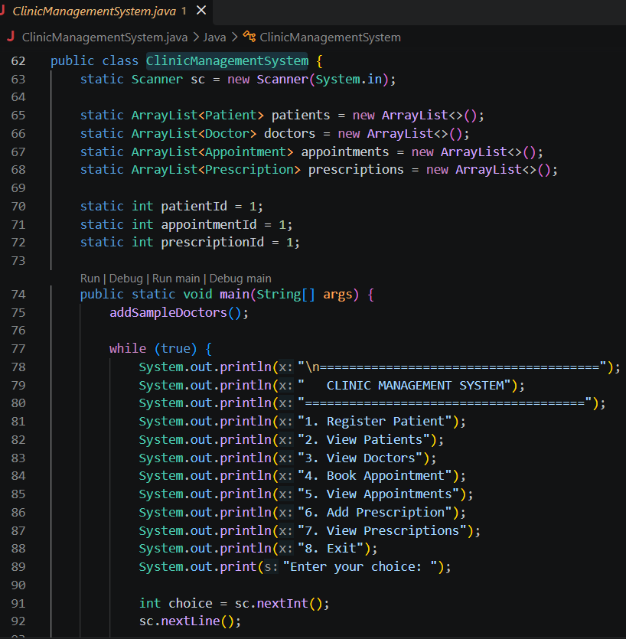

Slide 11
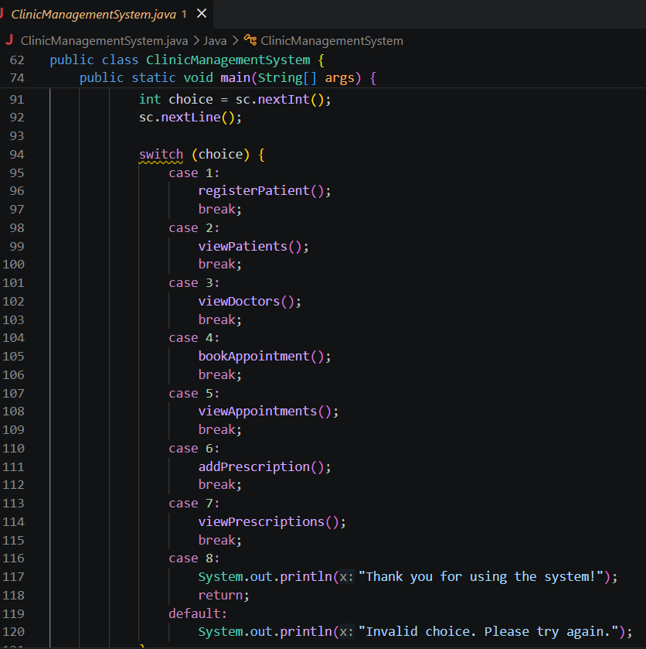
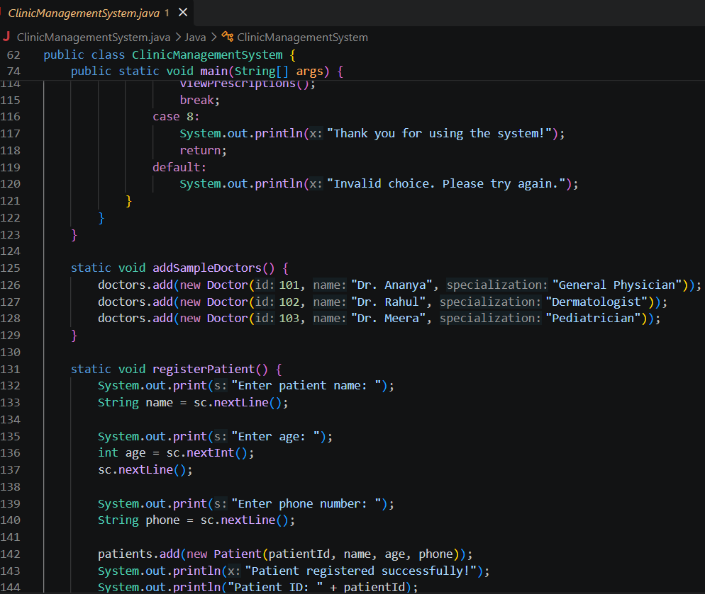

Slide 12
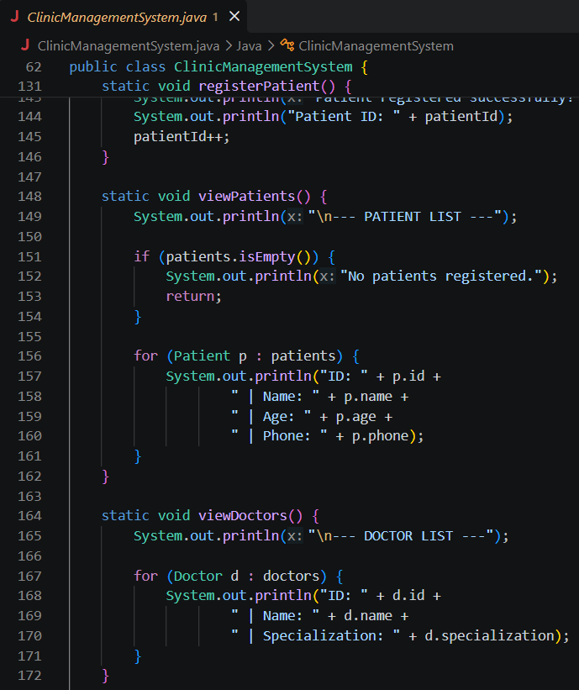
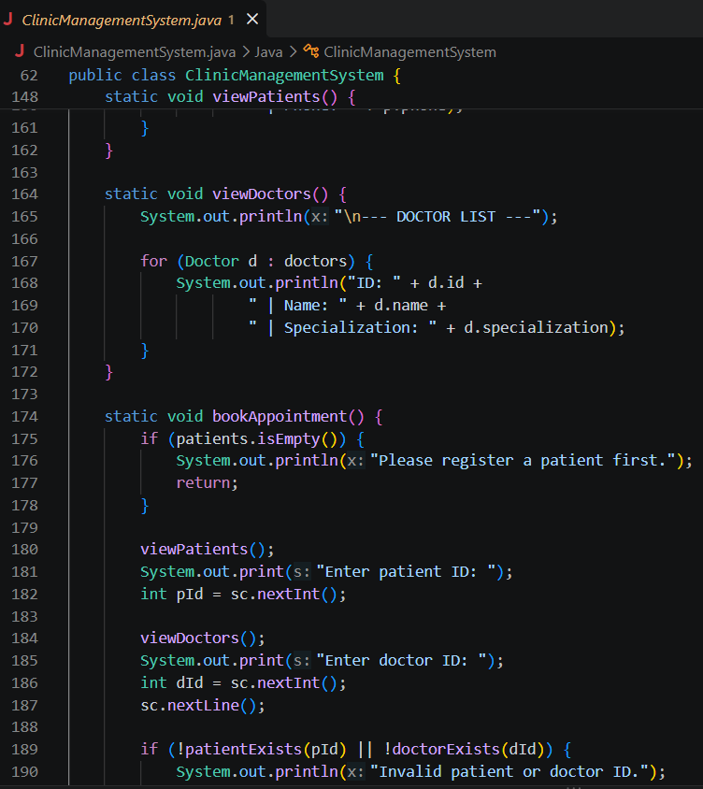

Slide 13
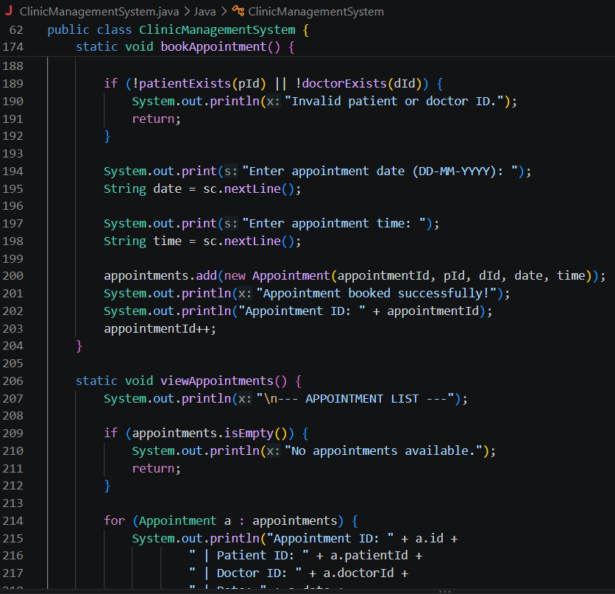
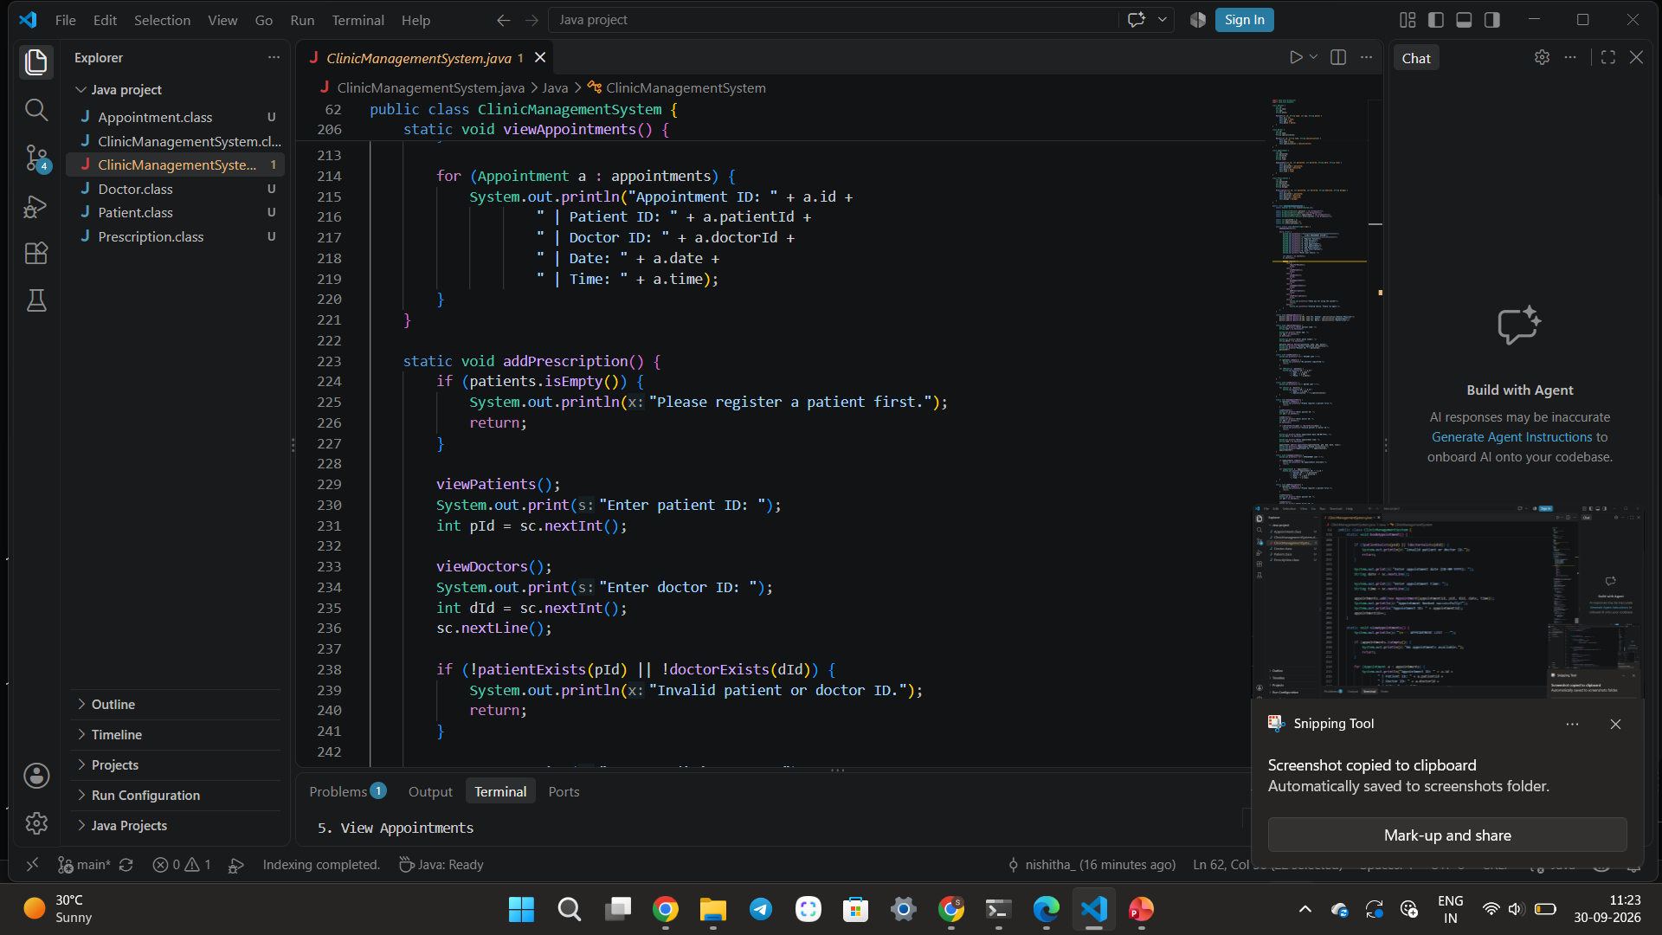

Slide 14
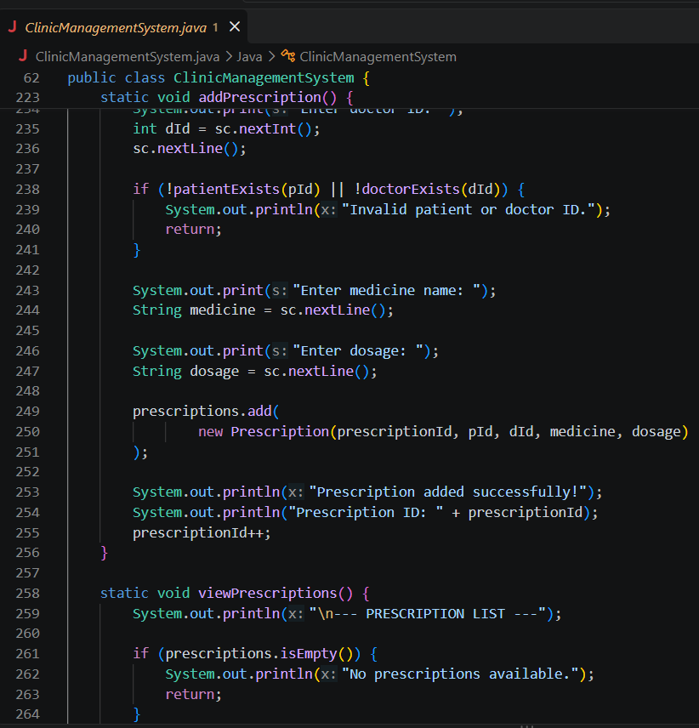

Slide 15
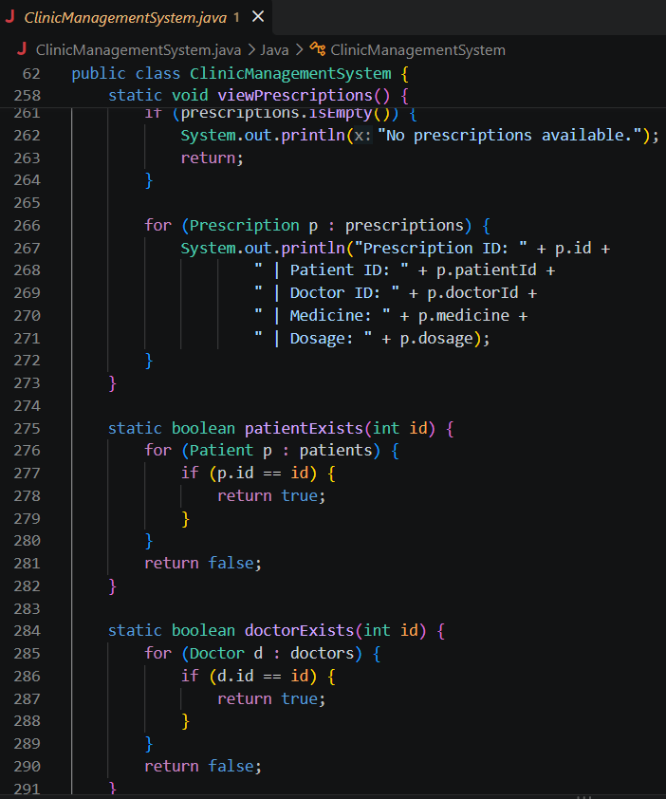
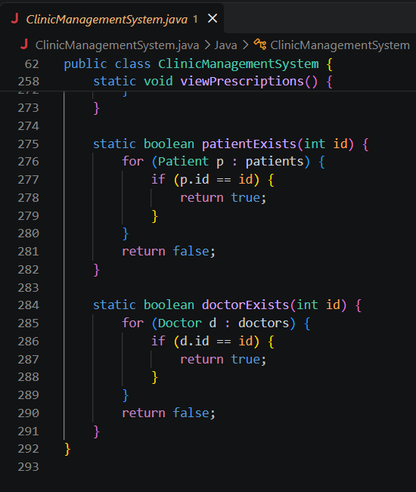

Slide 16
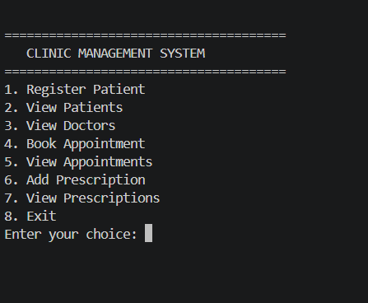
9. Output Screenshots
10
Recommended screenshots to insert:
• Main menu
• Patient registration success message
• Doctor list
• Appointment booked successfully
• Prescription added successfully
• View appointments / prescriptions
-ss

Slide 17
10. Future Scope
11
Connect the application to MySQL or another database.
Add login for receptionist, doctor and administrator.
Add appointment cancellation and rescheduling.
Generate printable or PDF prescriptions.
Add search by patient ID or name.
Create a graphical user interface using Java Swing or JavaFX.
Add automatic appointment reminders.

Slide 18
11. Conclusion
12
The project provides a simple way to manage basic clinic records.
It combines appointments and prescriptions in one Java application.
The project demonstrates classes, objects, ArrayList, methods, loops, if-else and switch-case.
It can be expanded into a database-based clinic management application.

Slide 19
THANK YOU
Questions & Discussion

